Slide 1
PLAGIARISM DETECTION USING MACHINE LEARNING
SUBMITTED BY:
SAHIL GULERIA (2104173)
HARNOOR SINGH (2203582)
KAUSHAL KUNDAN (2203586)

Slide 2
Introduction
The act of plagiarism is stealing another individual’s intellectual property, which comprises their literary work, creative output or ideas.
The act of claiming these as ones own without due acknowledgment and consent constitutes a direct violation of the principles of academic integrity, honesty and originality.
Avoiding plagiarism involves using your academic skills to make your work as good as it can be, not just making sure your references are all accurate or changing enough terms so the examiner won't catch you paraphrasing.
Learning and using the rules of good academic practice from the start of your university career is the greatest method to prevent plagiarism.
To assure originality and uphold ethical standards in academic and professional work, using plagiarism detectors and developing strong research and writing practices are helpful ways.

Slide 3
Objectives
To develop a web-based tool to detect plagiarism and provide report to the user.
To compare with available open-source plagiarism tools.
To study different algorithm in machine learning such as cosine similarity.

Slide 4
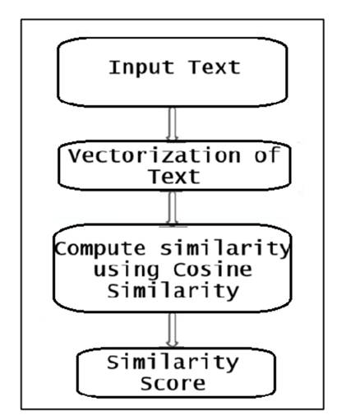
Methodology

Slide 5
Methodology
1) Input File
The input to the plagiarism detection system must be a text file, typically with a .txt, .pdf, .docx extension, to ensure compatibility.
2) Vectorization of text
Using Sci-kit’s built-in features, the words from the text input are transformed into a vector format, enabling further analysis.
3) Compute similarity
The similarity between two text files is computed using Cosine Similarity. This method determines how similar two vectorized text files are by calculating the dot product of their corresponding vectors, represented by cos(θ), where θ is the angle between the vectors.
4) Similarity Score
A similarity score is then derived, quantifying the degree of similarity between the two text files. The score ranges from 0 to 1, with positive values of cos(θ) indicating varying levels of similarity.

Slide 6
System Requirements
Hardware Required:
Processor: Intel core i3 Processor
RAM: Minimum 4 GB
Hard Drive: Maximum 1 TB
Internet: Required
Software Required:
Operating System: Windows 10,11
Programming language/Framework: Python, React
Libraries: Matplotlib, Scikit-learn, Flask
Integrated development environment: Visual Studio Code.
Web-Browser: Microsoft Edge, Mozilla Firefox, Google Chrome

Slide 7

Output Screens Home Page

Slide 8
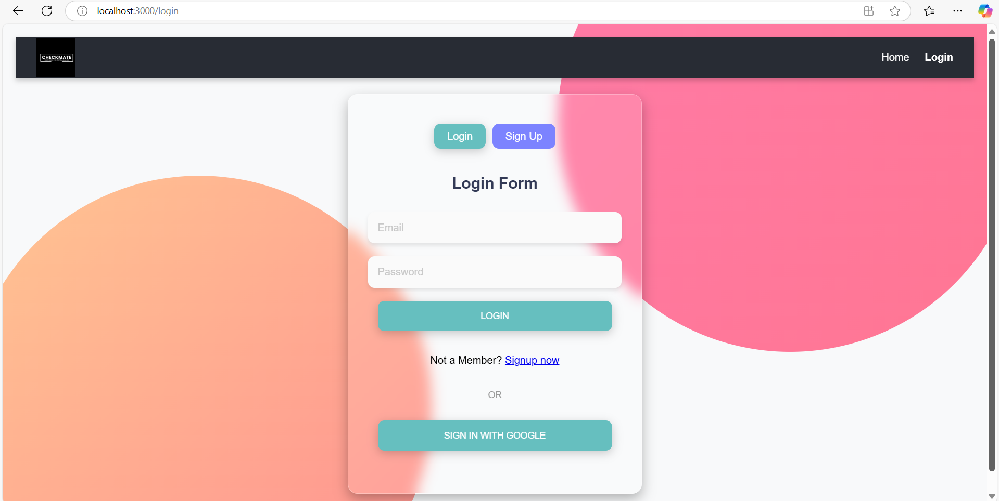
Login/Sign Up Page

Slide 9
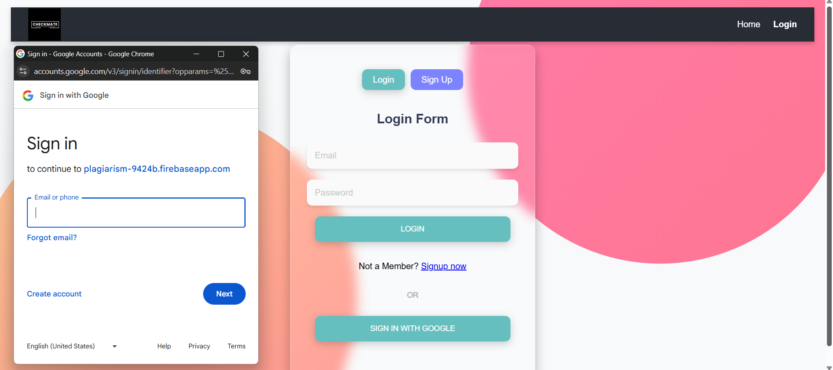
Sign-In With Google (Firebase Authentication)

Slide 10
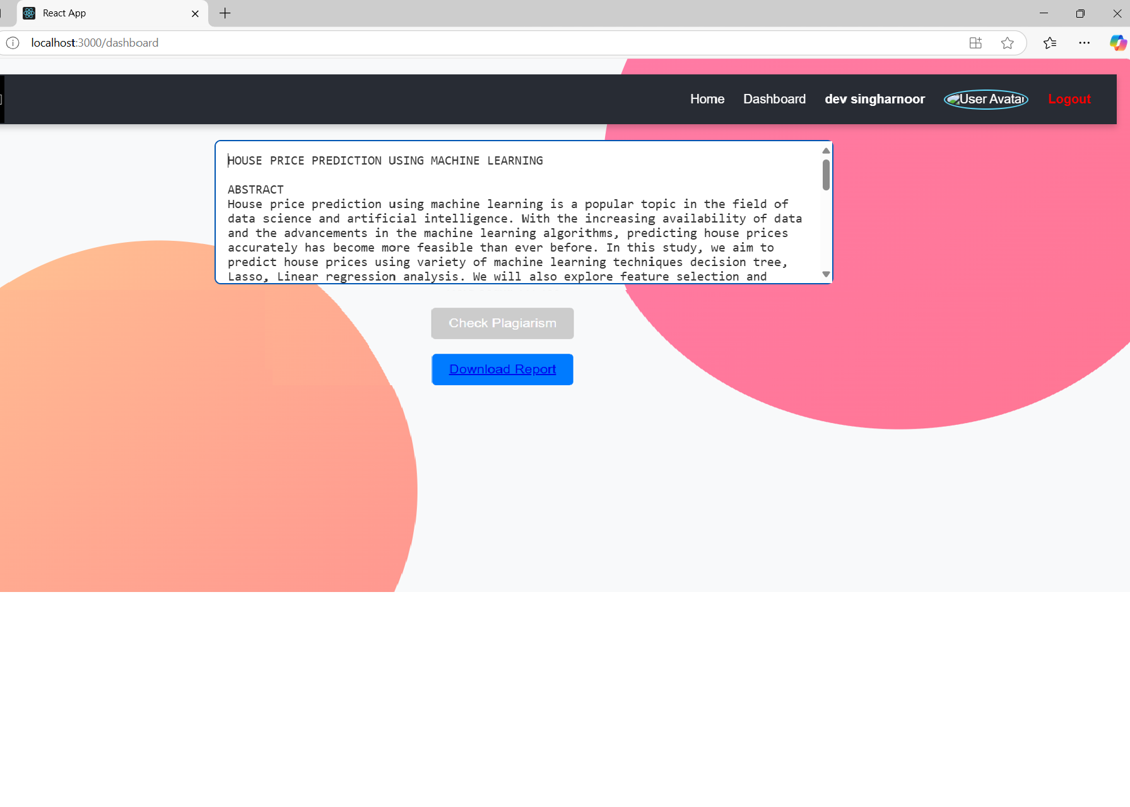
User Dashboard

Slide 11
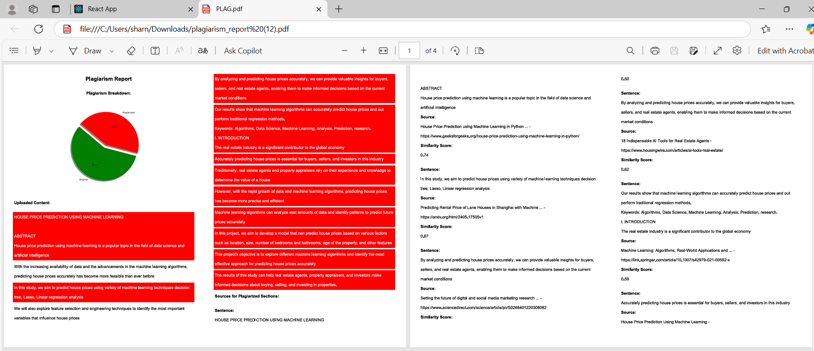
Generated Report

Slide 12
THANKS
SUBMITTED BY:
SAHIL GULERIA (2104173)
HARNOOR SINGH (2203582)
KAUSHAL KUNDAN (2203586)

